Slide 1

Impact of Covid Data in mobility and Wearable market
Prepared by : Mohammed Elbelbesy
Under the supervision of Prof. Dr. : Javier Valdes
Notes:
Photo by Carlos Muza on Unsplash

Slide 2
Table of Contents
Introduction to the situation and the problem.
Investigating the potential markets.
Results and Discussion.
Conclusion and recommended actions

Slide 3
Introduction
The COVID-19 situation is influencing customer behavior and, as a result, marketing strategies.
Consumers are being pushed to reconsider their objectives in life.
Asignificant influence on mobility behavior, Global Economy and wearable market.
Notes:
Free Photos to use from Unsplash and Pixabay

Slide 4
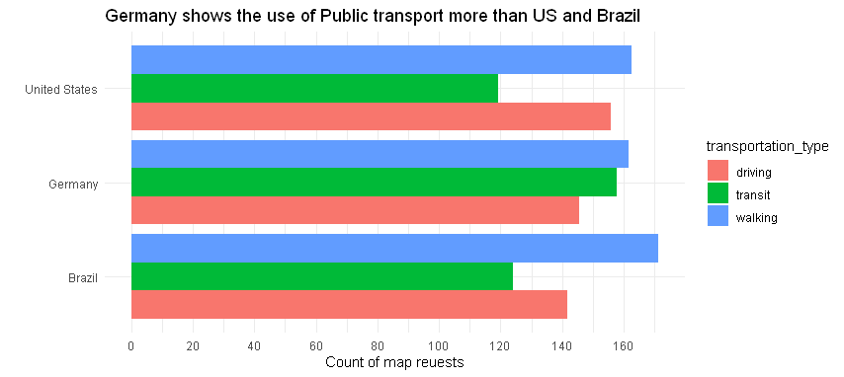
Investigating the potential markets
Germany Shows use of Public transport the most.
Brazil Shows the least use of Private Cars.

Slide 5
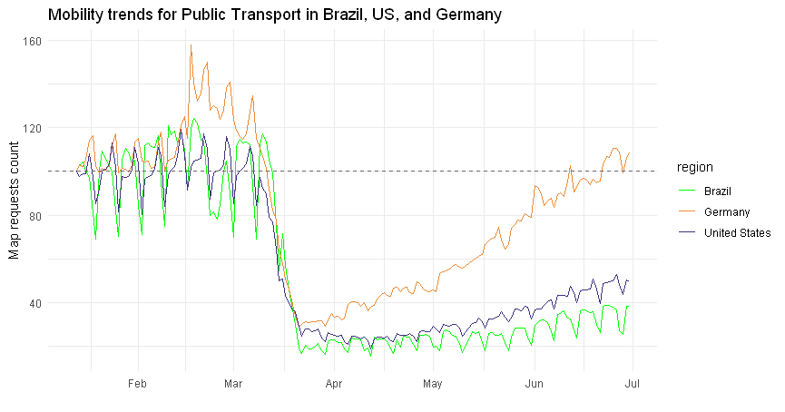
Results and Discussion
Public Transport
experienced the greatest fall by
In April
76%

Slide 6
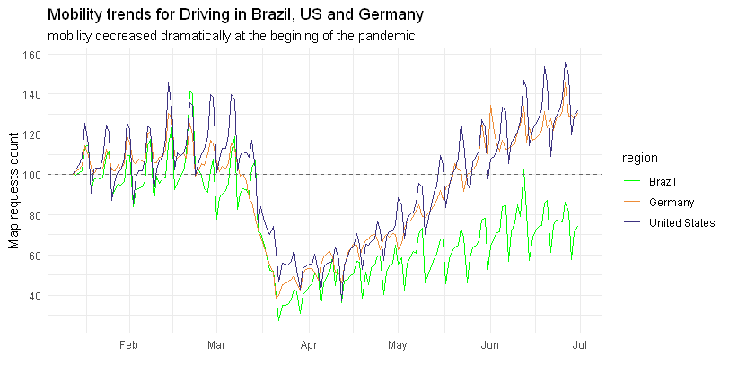
A Shift to use Private Cars in The US and Germany
Brazil Shows less use of Private Cars

Slide 7
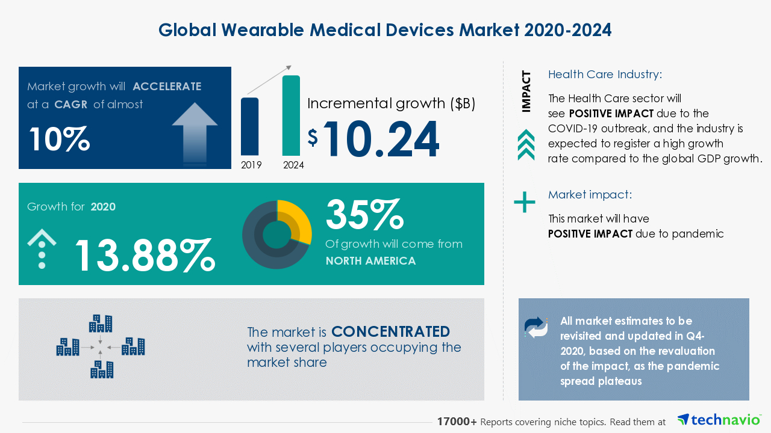
Global Wearable Medical Devices Market (Business Wire Technavio 2020)¹.
Notes:
1.Business Wire Technavio . (2020). Wearable Medical Devices Market Size Projection. Retrieved June 23, 2021, from businesswire: https://www.businesswire.com/news/home/20201104005367/en/Wearable-Medical-Devices-Market-Size-Projection-Growth-Value-Sales-Statistics-Share-Analysis-and-COVID-19-Impact-Analysis-by-2024

Slide 8



Recommended Actions
Measurement of Heartrate, Blood Pressure and Oxygen levels
Develop PROGRAMS
Expand online marketing
Provide SENSORS
MARKETING
strategies
Calories and steps Calculating
Alarm for the risky areas

Slide 9
Thank You!

